Slide 1

Year 5 Residential – Pioneer Centre
Wednesday 10th – Friday 12th April 2024
Make sure you have a kit list ☺

Slide 2

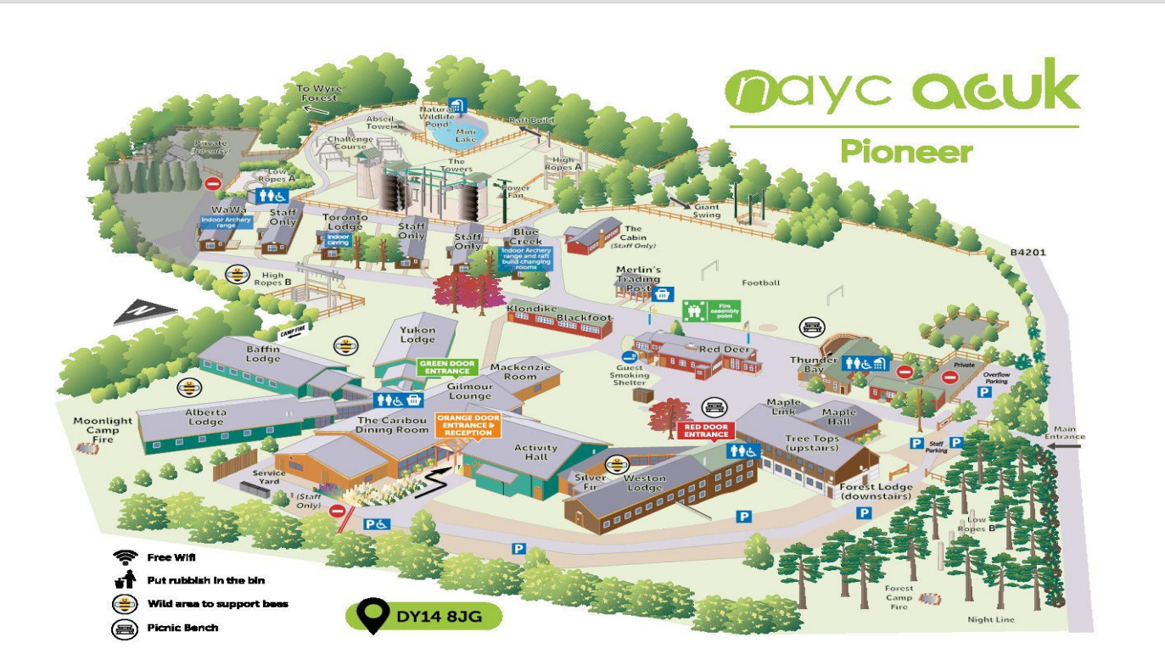


Slide 3
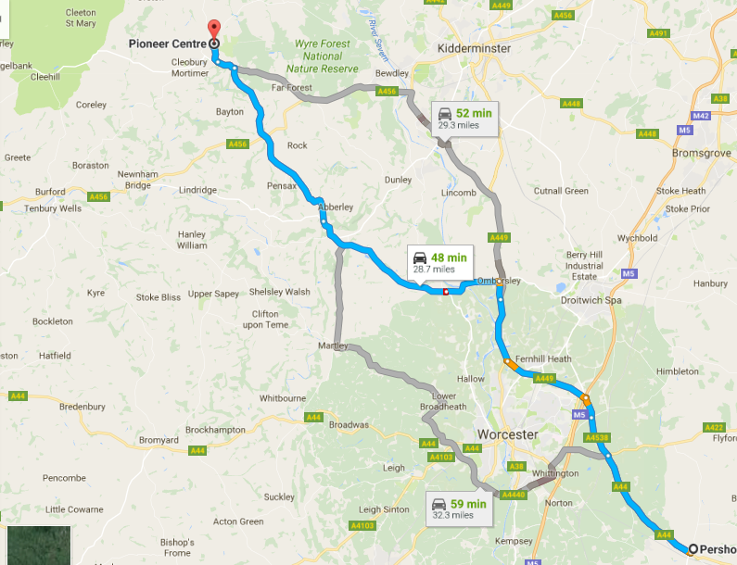


Slide 4

General information
4 members of staff (teachers and TAs) will be accompanying the children. Groups of around 10.
Miss Gorton (Trip leader)
Mrs Griffiths (Firecrest class Teacher)
Mr Ash (Teacher)
Mrs Williams (TA and First aider)

Slide 5
General information
Arrive at school as usual, with bags which will be placed in ‘Swan’s’ classroom in Year 5.
All children will need a packed lunch on the Wednesday.
Any medication needs to be clearly named and given to a member of staff with administration instructions (even paracetamol etc.).
Inhalers to be named but kept with child.
Depart St Nicholas between 9.30 and 10 am.

Slide 6
General information
All bedding is provided
Several changes of clothes are needed - layers are important!
Full kit list available this evening – no mobile phones or electronics.
Bring board games- named
Souvenir shop available - £5
Tuck shop is also available.
Please hand pocket money to a member of staff in a sealed, named and labelled envelope on Wednesday morning.

Slide 7
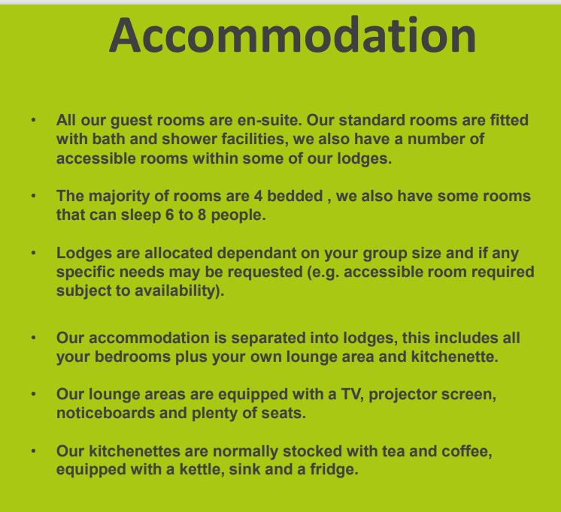
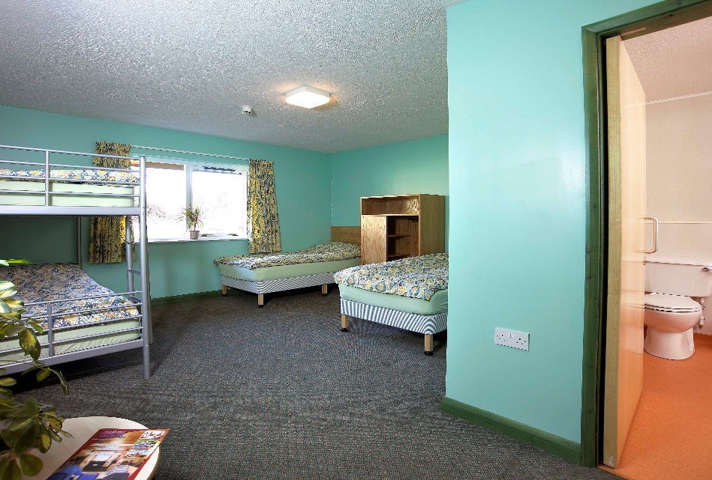
Room Allocation
Children will be with at least one friend in the room which they can nominate.
Day groups

Slide 8
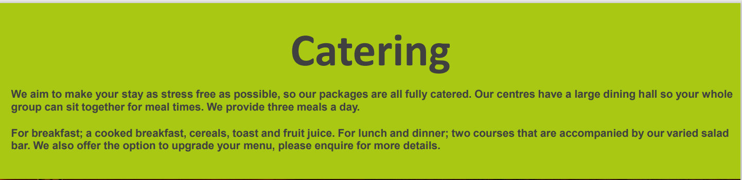
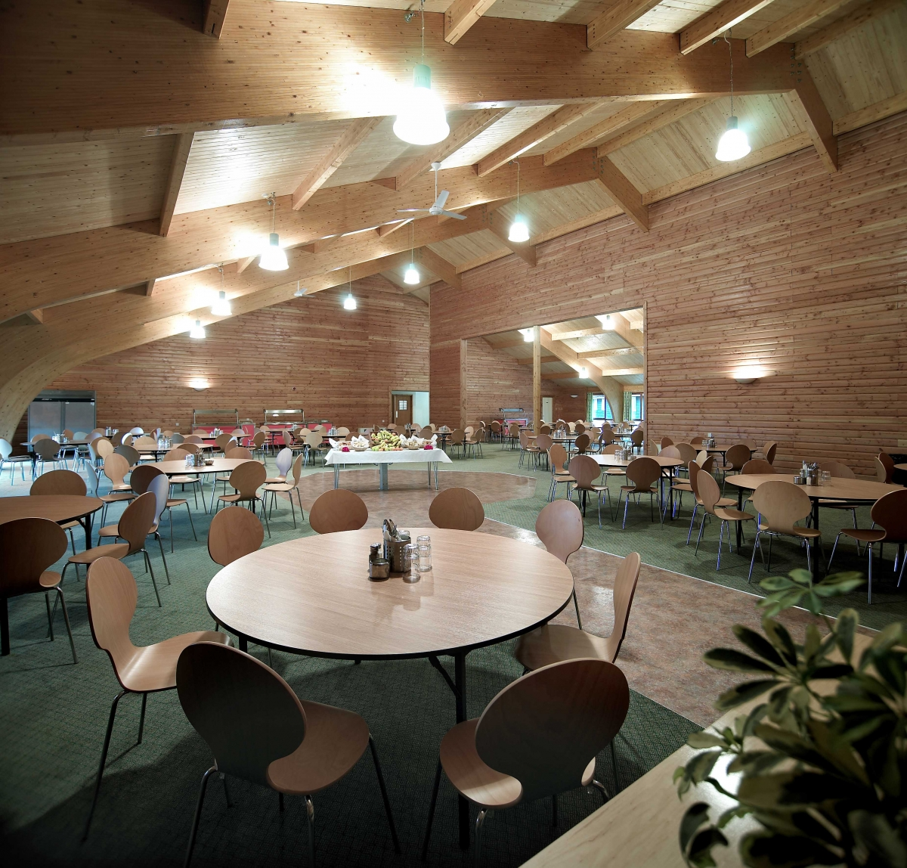
Dining
Dietary requirements should be handed into the office ASAP
Breakfast - hot and cold options
Lunchtime - Salad bar and hot option
Dinner - Hot food and salad bar

Slide 9

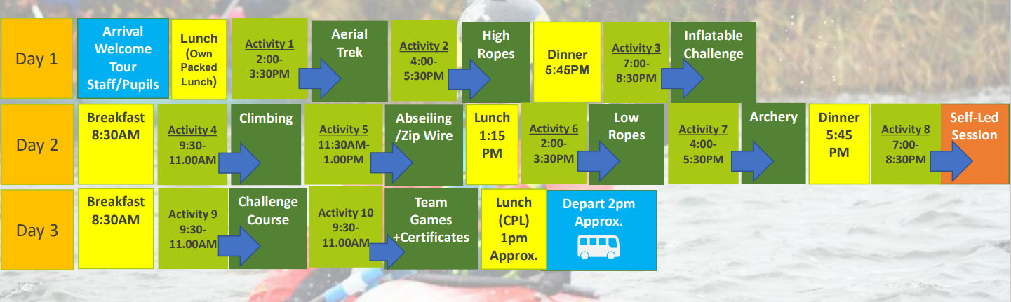
Activities

Slide 10
Friday 12th April
Return will be between 3:00 – 3:30.
Children can be collected from 3:30pm, once we have got all children and belongings from the coach into the hall.
A text will be sent to parents should there be any delays or changes.
Medication will be returned to parents.

Slide 11
Should you need to contact us:
We will update the school website with photos and the office will be in touch through text message during our stay.
No mobile phones.
If you ned to, please contact the school office who will then get in touch with us.

Slide 12

Thank you for time this evening.
Any questions?
Kit List available at the back of the room.

