Slide 1
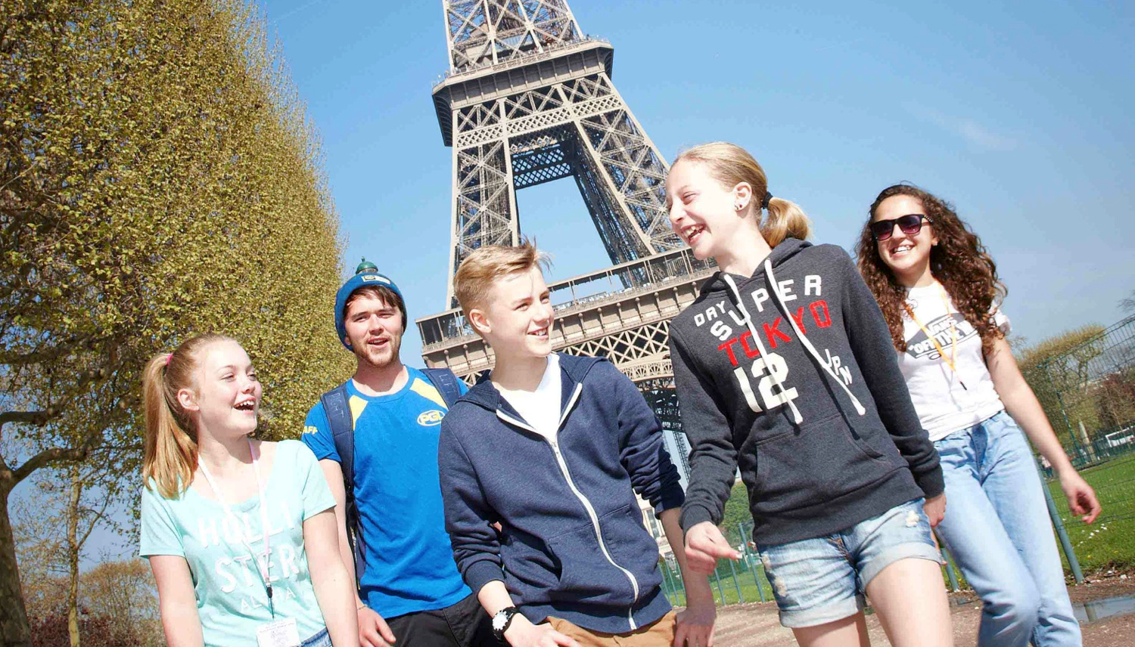
Bienvenue!
Welcome to our information session for the
Year 7 Paris Trip 2024

Slide 2

Party details
Trip leader: Mr Davids
Deputy leader: Miss MacKenzie
Year 7 class teacher (Eagle) Mr Summers
Miss Bristoll – Year 3 teacher and experienced on the Year 7 Paris residential.
Mrs L Williams – Middle School TA and First Aider
45 wonderful year 7s - also budding French speakers and all round excellent pupils !

Slide 3
Dates of travel
Meet at SNMS on Monday 6th May, at *approx. 4am for passport check & loading (depart at 4.30am)
Travel by coach to Dover for ferry to Calais (or Folkestone if we catch the Channel Tunnel)
Children will need a packed lunch for the outward journey and approx. £5 - £10 for UK service station stops.
From Calais by coach to the Vimy Ridge war memorial (visit then eat packed lunches)
We should arrive at the Chateau at around 5pm (French time) for a tour, evening meal and entertainment.
We will contact school informing them of our safe arrival & also post to social media.
Return to SNMS Friday evening 10th May (approximate arrival time to be confirmed by PGL once channel booking made).

Slide 4
Itinerary
Monday 6th May 2024
Afternoon: Vimy Ridge War Memorial, picnic
Evening Entertainment at the Chateau
Tuesday 7th May 2024
Provins – a medieval French town (possible show)
Afternoon Hypermarket
Evening Entertainment at the chateau
Wednesday 8th May 2024
Morning Bateaux Parisiens – river cruise
Afternoon Eiffel Tower (Ascend via Stairs)
Evening Entertainment at the Chateau
Thursday 9th May 2024
Morning: Musée du Louvre
Afternoon (1): Sacré Coeur and Montmartre
Afternoon (2) Coach tour around Paris with a chance to alight at various places (?)
Evening Entertainment at the Chateau
Friday 10th May 2024
11:30 Chocolaterie de Lachelle

Slide 5
Essential things to remember…
Passports!! Hand in to us before boarding coach on departure morning.
Must have 3 months validity from return date
We have asked for permission to make a photocopy to enable us to complete border documentation prior to departure. We will be asking you to send this in with your child next week to be photocopied or send in a photocopy as soon as possible.

Slide 6
Essential things to remember…
2) GHIC / EHIC card
This is free to apply for through the NHS website.
Please bring your child’s GHIC/EHIC into school (unless you need it beforehand, so we can make sure everyone has one and they are all valid). You can hand it in this week if you wish.

Slide 7
Pocket money!
40-50 Euros as a suggested amount.
We would prefer money to be sent into school prior to the trip – in a named envelope.
We will take it with us & a ‘Bank’ system will operate each day. Children will sign to say how much they’ve taken & it then becomes their responsibility!
There will likely be two stops at English services, one each way.

Slide 8
Medicine administration
Medicines prescribed by GP can be stored and administered by Mrs Williams.
Name & details of administration should be clearly labelled on the medication when group gathers on the morning of departure and signed in to Mrs Williams.
Over the counter remedies e.g. medicines for migraines, antihistamines etc. can also be administered with clear guidance from parents/carers.
If appropriate, travel sickness tablets etc. should be taken prior to the outward journey & additional ones sent for longer journeys during the week & the journey back to England
Children should carry their own asthma medication and, ideally, a spare inhaler should also be handed to staff

Slide 9
Kit List
The key is to remember it is not a fashion show & comfort is important!
The weather is not guaranteed – Pack lightly with clothes to suit sun and rain – also pack sunscreen / sunhats/caps.
Insect repellent roll on
DVDs for the bus – U only!
Digital Cameras (which will be collected by group leaders each evening)
Hand held gaming devices such as the old PSP or DS (without the camera) but NOT the Switch as this can connect to the internet.
European adaptor (Each room does have at least one UK socket)
NO MOBILE PHONES or devices which connect to the internet – This is imperative for safe-guarding reasons. Any mobile phones found will be confiscated so please do not allow your children to pack theirs!

Slide 10
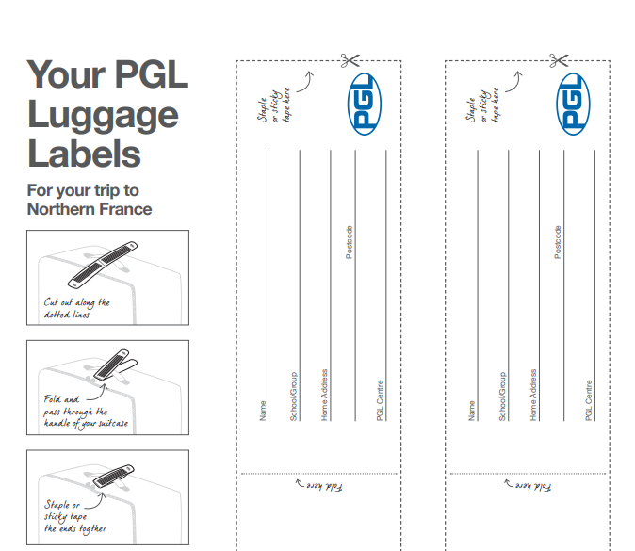
Please label your child’s luggage

Slide 11
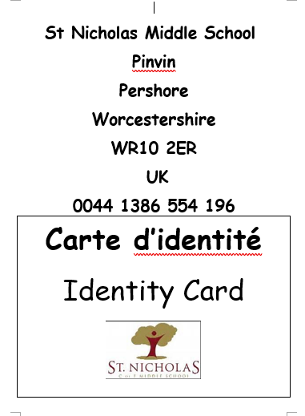
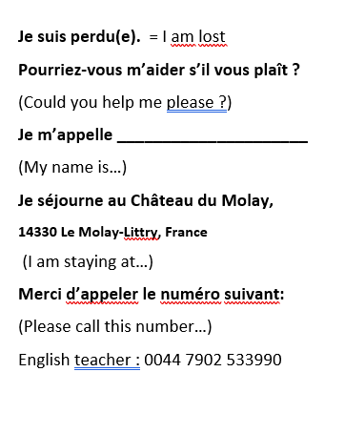
Example of ID card children will carry

Slide 12
Fund raising
What you have paid for:
- All travel coach, ferry and travel within Paris for 5 days.
- Three meals a day while at the chateau including a packed lunch on the way home.
- 4 nights accommodation at the chateau.
- all entertainment and activities at the chateau.
What has not been covered:
Parking for the coach at Provins and show.
Bateaux Parisiens – river cruise
Access to the Eiffel Tower
Entrance to Musée du Louvre
Entrance to Chocolaterie de Lachelle
Money for those in year 7 who are not going so that they can have a ‘French experience’
This is an additional £1500

Slide 13
Behaviour
Before we look at the Chateau, I wanted to take a moment to remind you of the importance of expected behaviour during this residential. Our aim is to ensure a safe and enjoyable experience for all students involved.
Throughout the trip, whether we're traveling on the coach, crossing on the ferry, staying at the chateau, or museums/wandering the streets of Paris, we expect nothing less than the highest standard of good behaviour from every student. It's imperative that they represent themselves, their families, and St Nicholas Middle School with dignity and respect.
Please emphasize to your child the significance of their conduct, as we will be interacting with members of the public and it's crucial to maintain a positive impression. Silly or dangerous behaviour will not be tolerated under any circumstances.
In the event of any behavioural issues, students will be given warnings. However, if their actions pose a risk to themselves or others, they may be required to sit out of certain activities. It's essential to note that our student-to-teacher ratios are meticulously planned, and any disruption affects the entire group. Consequently, if a student cannot participate in an activity, it impacts the entire group dynamic, as we cannot leave any child unattended.

Slide 14
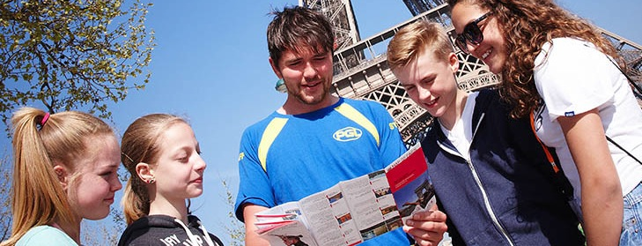

Agenda
Welcome to PGL
Château de Grande Romaine - Paris
The PGL difference
Popular excursions
Adventure activities
Accommodation & Facilities
Catering and dietary needs
Health & safety
Travel
Questions?

Slide 15
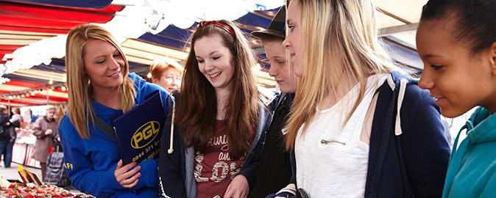



Bienvenue à PGL
The market leader
Over 60 years’ experience
Fully risk assessed
ABTA bonded
Founding member of BAPA
Notes:
PGL provides a wide range of top quality residential adventure and educational courses for more than 4,500 groups every year
All PGL centres and activities are risk assessed to comply with legal requirements and best practice. Risk assessments are available by request and on the PGL website
ABTA (Association of British Travel Agents) bonded means your money is protected
BAPA – British Activity Providers Association. Responsible for establishing operating guidelines for the activity holiday industry.

Slide 16
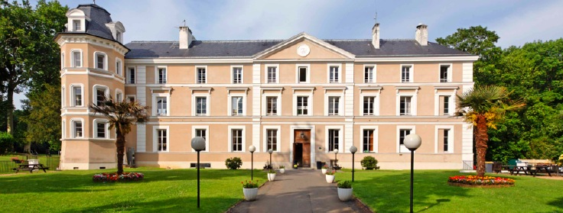
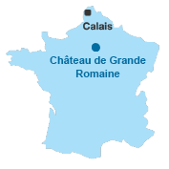
LEARNING OUTSIDE
Château de Grande Romaine - Paris
Rural setting, just 20 miles from Paris
Opportunity to use French in real-life situations
Authentic French experience with the comforts of
home
Owned & managed by PGL
Notes:
20 miles from Paris
Set in 70 acres of attractive, self-contained grounds
Used exclusively by PGL guests

Slide 17
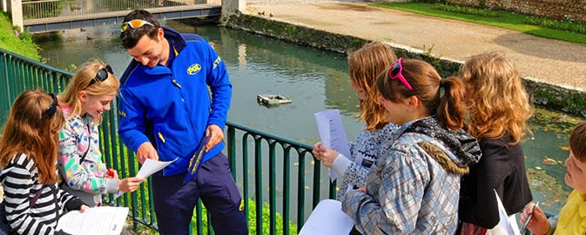
The PGL difference
Dedicated PGL Tour Leader
Tailored excursion programme to cultural places of interest
On-site activities
Evening entertainment programme
French language spoken and encouraged
24-hour support from our centre team
Notes:
Your PGL Tour Leader will have a wealth of local knowledge and will accompany you on excursions so you can make the most of your time away.
A PGL Animateur also organises optional on-site adventure activities plus evening entertainment

Slide 18
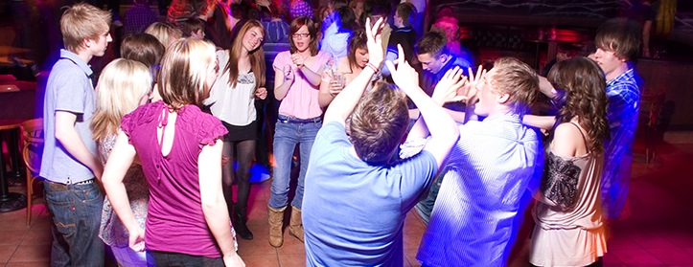
Evening entertainment
Snail tasting
Crêpe making
Boules tournament
Disco
Evening around the campfire
Mini Olympics
Talent Show

Slide 19
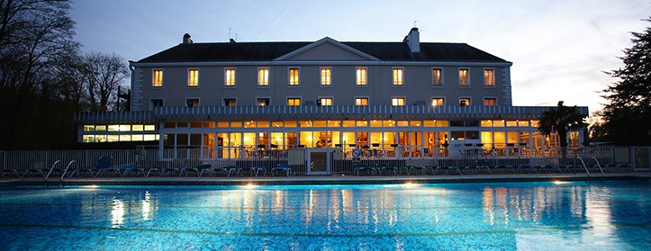
Accommodation and facilities
Comfortable 4-8 bunk-bedded rooms
En suite facilities
Extensive grounds for ball sports
Heated outdoor pool
Traditional boules pitch
Football pitches & basketball courts
On-site adventure activities
Disco
Shop
Games room & cinema room
Classrooms
Wi-Fi (Château Leaders Lounge)
Notes:
€5M investment including a brand new and refurbished accommodation
The centre can accommodate 500 guests at a time in three separate purpose built accommodation blocks.
Pupils are accommodated in 4-7 bedded rooms, all en suite with shower and toilet facilities
Teachers are usually accommodated in twin rooms with en suite and hot drink facilities
All rooms are lockable with card key (party leader given master key)
All exterior doors and gates are locked at night
A PGL staff member is available on duty throughout the night (contactable by phone)
The extensive facilities (other than activity bases) are available to your group during free time
The outdoor heated swimming pool is usually available May – Sept. Sessions are booked in advance with the Tour Leader on arrival at the centre

Slide 20
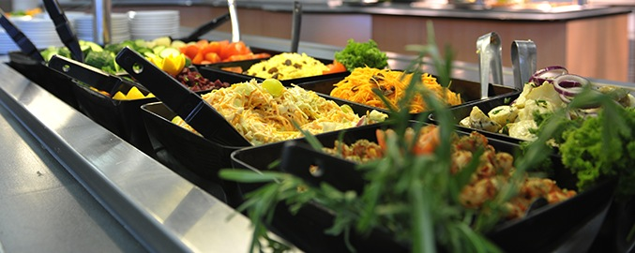
Catering and dietary needs
3 nutritious, balanced meals per day
Self-service salad bar
Vegetarian option
Special diets catered for by prior arrangement
Opportunity to try local dishes – including snails!
Sample menus available online: www.pgl.co.uk
Notes:
We continually invest in healthy menus with freshly cooked ingredients obtained from fully traceable audited suppliers
Processed food is avoided and meals meet Local Authority guidelines
Breakfast is continental style with a choice of cereals, bread, butter and jam plus hot and cold drinks
A packed meal is provided for lunchtime. Guests will prepare their own sandwiches at breakfast. We also provide water, crisps, fruit and cake or biscuits.
Dinner is a self-service 2 course meal.
At each evening meal the buffet includes a salad bar and mixed fruit basket plus hot and cold drinks
There is always a vegetarian option but please advise us of this requirement in advance
Our caterers can deal with most dietary requirements but please ensure the party leader is aware of any dietary requirements well in advance. Where the ingredients are not available in France we may ask you to bring certain items with you

Slide 21
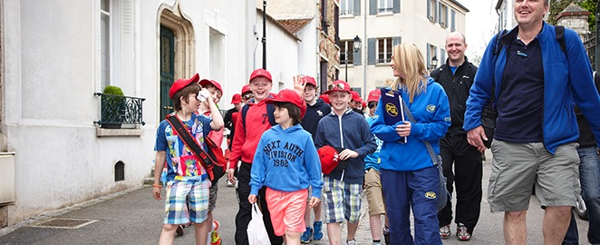
Health & safety
The PGL Code of Practice describes all safety and operational procedures both on and off-site including:
Sample risk assessments
Staff-to-pupil ratios
Operating procedures
Staff vetting & training
Site security
First Aid procedures
Emergency procedures
www.pgl.co.uk/cop
Notes:
Please see Code of Practice for further detail
All centres and activities are fully risk assessed every year.
The PGL Code of Practice details all the control measures put in place to minimise risk.
Sample risk assessments are available on line and specific assessments are available from PGL on request.
Staff to pupil ratios comply with recognised industry standards.
Operating procedures all comply with recognised industry standards and National Governing Body guidelines where these are relevant.
PGL recruitment officers have extensive experience at a senior level on centre and make selections based on a detailed application form.
Two formal written references are taken and applicants have to provide documentary evidence of all qualifications claimed.
All offers of employment are subject to DBS checks, the successful completion of pre-employment training and a favourable probationary period.
All our instructors are specifically trained for our programmes to ensure the delivery of safe and rewarding sessions across a wide range of activities.
At every PGL centre there is an experienced and professional Centre Manager (supported by Senior Staff) who is in charge of centre operations and has overall responsibility for the success of the course and the performance of our staff.
It is the policy of PGL to take all reasonable steps to ensure the safety and security of all guests and staff on our centres (details in Code of Practice).
Each centre has at least two First Aid staff who hold the “First Aid at Work” qualification and in addition all our instructors and group leaders complete an 8 hour first aid course. Party Leaders and teachers will ultimately remain responsible for the administration of first aid to their party members.
There are rigorous general accident and emergency procedures in place.
Through the Quality Badge Programme you can be confident that recognised providers fulfil all the necessary criteria as laid down by the DfE, thereby better enabling Party Leaders to manage visits safely, efficiently and beneficially.

Slide 22
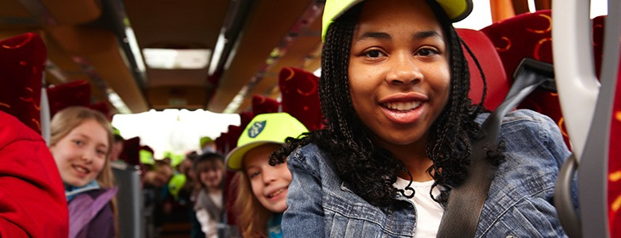
Travel
Approximate travel times:
Dover to Calais by ferry – 90 minutes
Folkestone to Calais via Eurotunnel – 35 minutes
Calais to Château de Grande Romaine – 41/2 hours by coach
Notes:
Brochured tours normally include an executive coach with additional facilities and air conditioning
PGL follows a strict policy for the selection and use of Coach Operators (for details see Code of Practice).
All travel itineraries are checked to ensure they comply with EEC Drivers’ Hours Regulations.
En route stops are made throughout the journey for toilet, refreshment and meal breaks.
We suggest that parents supply picnics, snacks etc. for the outward journey especially if travelling a considerable distance to the channel port. Regular stops will be made en route, but service areas can be expensive. Euros will be required for stops abroad.
N.B. Meals en route to the resort are not included in the course cost, a packed lunch is supplied for the return journey.
There will be space for one piece of luggage per person plus a small piece of hand luggage. Please ensure that pupils plan their packing so that everything they need on the journey is taken on board at the outset.

Slide 23
PGL includes extensive insurance cover organised through travel insurance specialists.
**You may wish to purchase additional insurance
Please limit luggage to one case/bag per person and one item of hand luggage for carrying food etc. on the journey.
The kit list has been provided by email, however we would like to stress that:
  Old, casual clothes are recommended
  Pack more clothes if it is likely to be wet weather.
  All clothing should be marked with the student’s name and school.
  Brand new and expensive items should be left at home.

Slide 24
Fire and contact
Deodorants - It is advised that children bring roll-on deodorants rather than aerosol deodorants as these can often set off fire alarms.
Contacting your child - Parents are asked not to call the centre except in an emergency. The centre telephones are business lines and may be needed for emergencies. (Mr Davids will be updating our SNMS facebook page daily so you will be able to see how we are getting on and what we have been doing each day.)

Slide 25
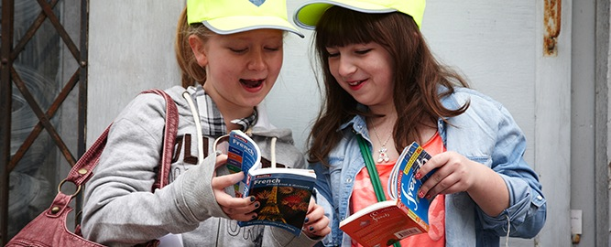
Thank you for listening
Any questions?
Notes:
Questions?

